Slide 1
NES Project – Task 5 Collision Detection
Daniel José Febles Bustillo

Slide 2
Video Objectives
Integrating a collision parameter into player movement
Explain the importance of organizing your data
Discussing the edge cases regarding collision
Shows the results of the process

Slide 3
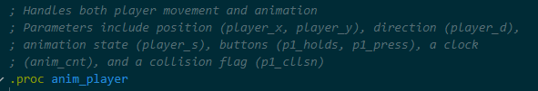
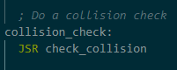
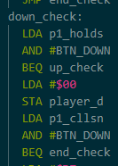
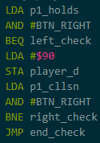
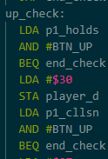
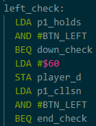
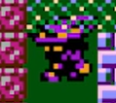
The Player and Collision
Collision should determine whether or not the player is allowed to move into a tile
For simplicity’s sake, collision will be done at a metatile level using the screen data
Should collision directly affect the button?
Player might not be able to tell if button inputs are being registered
Animate the player while the button is pressed, but don’t move them if they are colliding

Slide 4
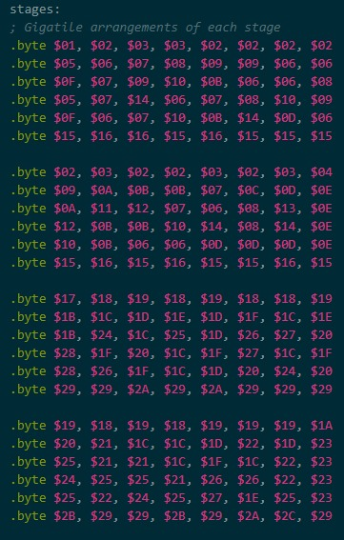
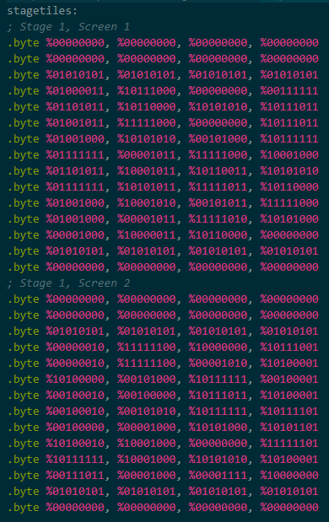
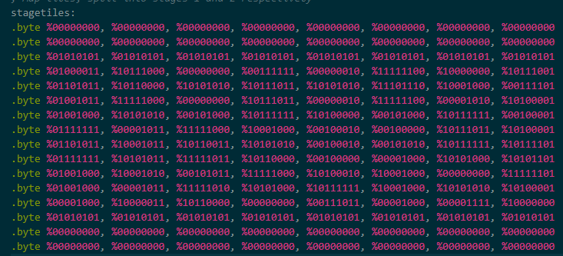
How Data Organization Matters
Fun fact about collision: it’s hard
This was the hardest task for me as the trial and error caused that I not only did this part three times, but also task 4 three times
How you organize your data is VERY important
First attempt had screen data organized in metatiles of metatiles, which made collision checking too cumbersome
Second attempt had screen data as different chunks, which made collision between screens clunky
Third attempt connected the two screens together, which made collision immensely more manageable

Slide 5
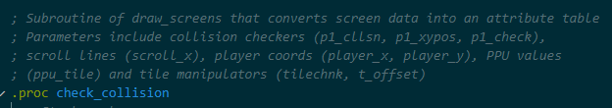
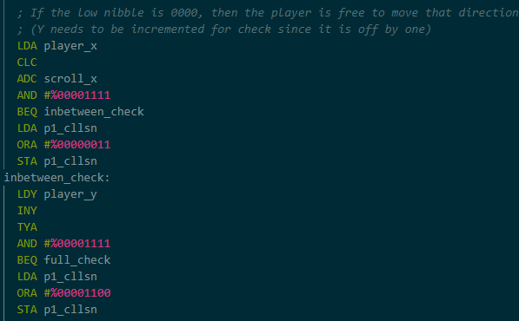
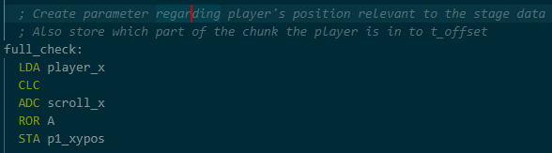
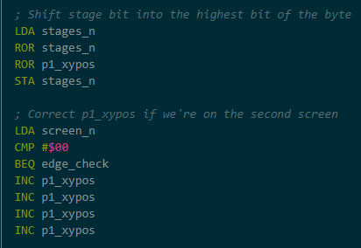
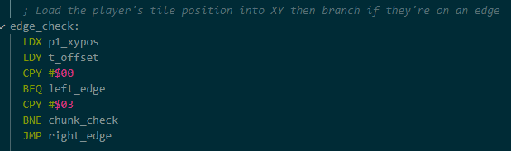
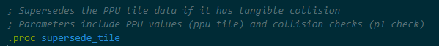
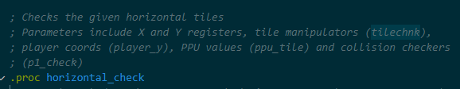
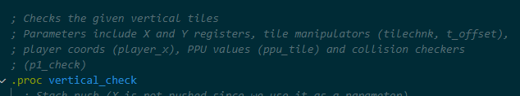
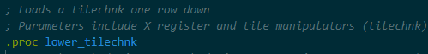
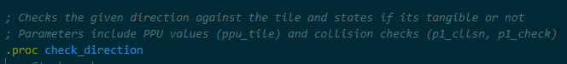
Collision is Massive
Collision has a lot of edge cases involved
Need to factor in when the player is in between metatiles
Convert the player coords into stage data coords
Need to combine player_x with scroll_x
In which stage and screen the player is in also matters
If the player is at the edge of a chunk, check the edges of neighboring chunks
Which part of the chunk the player is in needs to be found
Player can overlap two chunks and that can supersede collision
Check metatiles above and below player
In short, it’s not hard to see that collision is big
Once again, use bit manipulations to extract all the data and subroutines to make non-linear operations

Slide 6
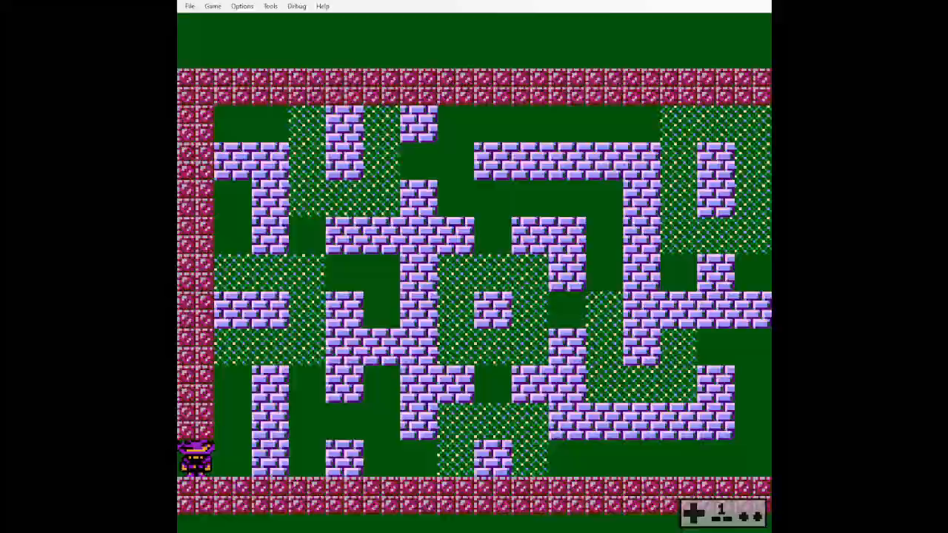
Final Result

Slide 7
Thank you for your attention

